Slide 1
WEB & Mobile Application development
Module – 02
JS Class 04
Saylani Mass IT Training Faisalabad
Instructor : Umair Azmat
WhatsApp : +923217061116

Slide 2
Operators
Operators are a fundamental building block of programming and help us to write more concise and efficient code. They allow us to perform complex operations on data and make decisions based on the results of those operations.
Operators are symbols or keywords in programming languages that perform operations on values or variables. They are used to manipulate data and control the flow of a program.
Arithmetic Operators: +, -, *, /, %, ++, --
Assignment Operators: =, +=, -=, *=, /=, %=, **=
Comparison Operators: ==, ===, !=, !==, >, <, >=, <=
Logical Operators: &&, ||, !
Bitwise Operators: &, |, ^, ~, <<, >>
Ternary Operators: ? :
Type Operators: typeof, instanceof.

Slide 3
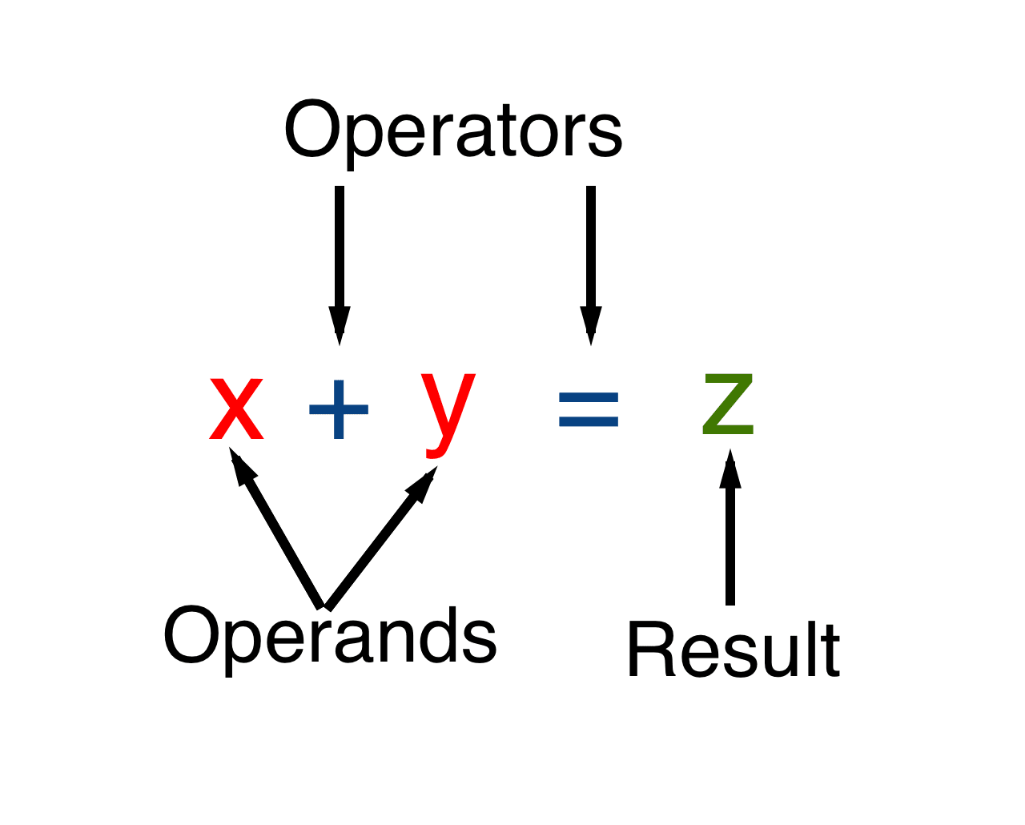
Operators and Operands
An operand – is what operators are applied to.
For instance, in the multiplication of 5 * 2 there are two operands: the left operand is 5 and the right operand is 2.
Sometimes, people call these “arguments” instead of “operands”.
An operator – is unary if it has a single operand.
An operator is – binary if it has two operands.
Operators are symbols in programming languages that perform specific operations on operands (values or variables).
For example, in mathematical expressions, an operator might be "+" for addition, and the operands would be the numbers being added.

Slide 4
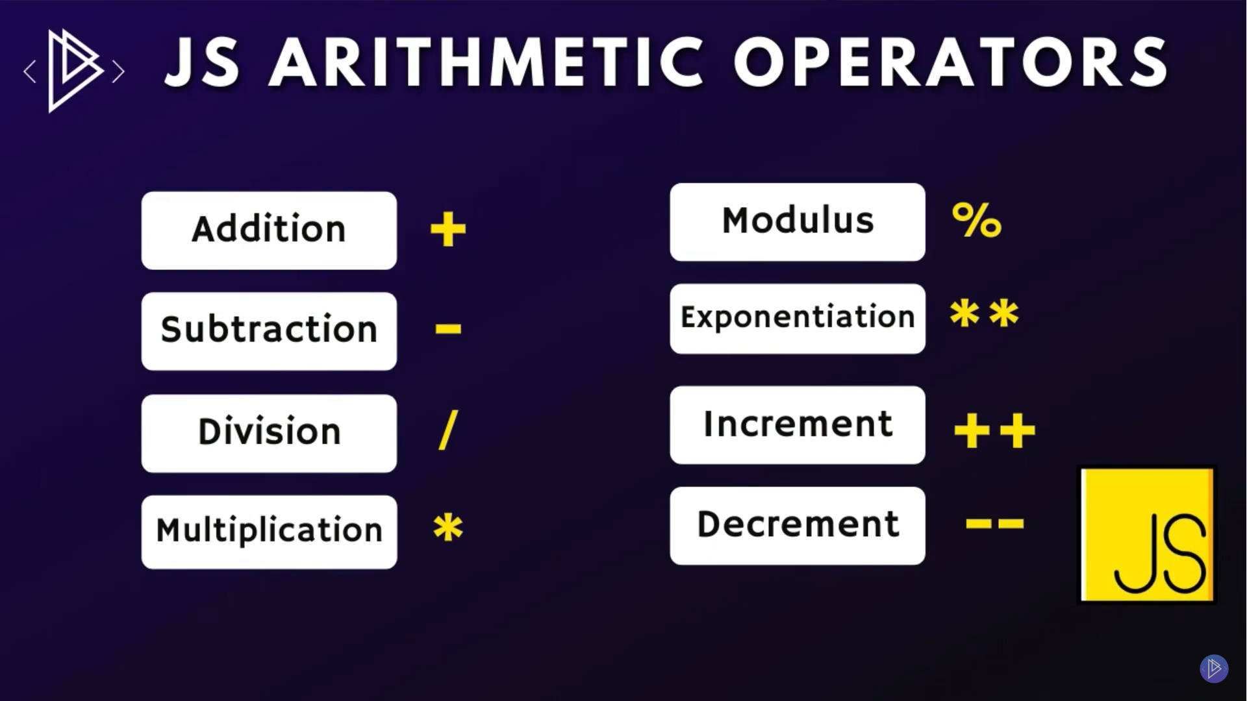
Arithmetic Operators
BODMAS

Slide 5
Arithmetic Operators
Addition (+): Adds two operands
Subtraction (-): Subtracts one operand from another
Multiplication (*): Multiplies two operands
Division (/): Divides one operand by another
Modulus (%) : Returns the division remainder of two operands
Exponentiation (**) : Returns the first operand raised to the power of the second operand.
Increment (++): Increment operator is used to increment a value by 1
Decrement (--):Decrement operator is used to decrement a value by 1
NOTE: operator can be placed before (prefix) or after (postfix) the operand.

Slide 6
Assignment Operators
Simple assignment (=): Assigns the value of the right operand to the left operand
Addition assignment (+=): Adds the right operand to the left operand and assigns the result to the left operand
Subtraction assignment (-=): Subtracts the right operand from the left operand and assigns the result to the left operand
Multiplication assignment (*=): Multiplies the right operand with the left operand and assigns the result to the left operand
Division assignment (/=): Divides the left operand by the right operand and assigns the result to the left operand
Modulus assignment (%=): Divides the left operand by the right operand and assigns the remainder to the left operand
Exponentiation assignment (**=): Raises the left operand to the power of the right operand and assigns the result to the left operand

Slide 7
Comparison Operators
Equal (==): Returns true if the operands are equal, and false otherwise
Not equal (!=): Returns true if the operands are not equal, and false otherwise
Strict equal (===): Returns true if the operands are equal and of the same type, and false otherwise
Strict not equal (!==): Returns true if the operands are not equal or not of the same type, and false otherwise
Greater than (>): Returns true if the left operand is greater than the right operand, and false otherwise
Less than (<): Returns true if the left operand is less than the right operand, and false otherwise
Greater than or equal to (>=): Returns true if the left operand is greater than or equal to the right operand, and false otherwise
Less than or equal to (<=): Returns true if the left operand is less than or equal to the right operand, and false otherwise

Slide 8
Thanks!
Do you have any questions?
umairazmat8115@gmail.com
+923217061116 umairazmat.me

